Slide 1
Smart drainage system
By,
Jayasurya Arasur Subramanian (267412)
Moises Romero Romo (266567)

Slide 2



Introduction
One of the important needs of keeping the city clean was a perfect drainage system so each and every city has its own drainage system.
Due to lack of knowledge the worker may meets to an accident as they have no idea how will be the condition in those manholes.
To overcome this situation, we proposed a smart drainage system which will monitor the flow, chemical content and the blockage in the system

Slide 3
OBJECTIVE OF OUR PROJECT
Finding the blockage in the pipelines.
Finding the level of poisonous gas in the pipeline.
To find the water level in the sewage system.
Intimating the concern people if there is an problem.
To keep the city clean and healthy.

Slide 4
Proposed System
Sensors to detect blockages, gas and excess of water.
System identifies location of the blockages and gives the location to the municipality.
System senses the hazardous gases like Methane and Carbon monoxide.
As the gas level increase, our system automatically opens the emergency vents and sends an notification to the health department to take necessary actions.
As the water level increase our system automatically opens the emergency outlet to reduce the possibility of flooding and intimate to the concern department to take necessary actions

Slide 5
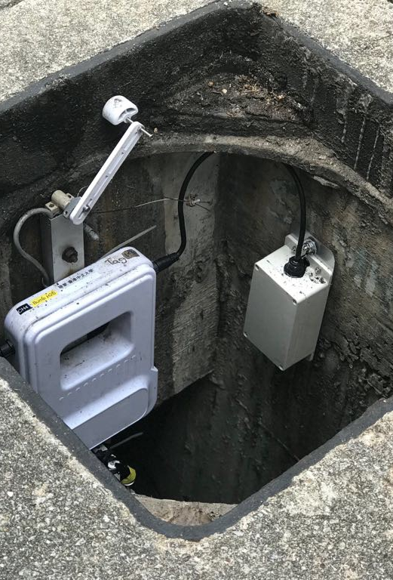
Working Principle
we are placing our sensors in the manholes to detect the required details and to transfer the sensed data about harmful gases, water level in the system and flow rate of the water.
Based on the data values given by the sensors in the drainage system along with the location ID, will send to the gateway and to processing unit. The processing unit will decide what action should be taken.

Slide 6
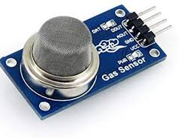
Sensors used
1. Gas sensor.
MQ7
MQ2
2. Water level sensor.
3. Flow sensor.

Slide 7
Block Diagram.

Slide 8
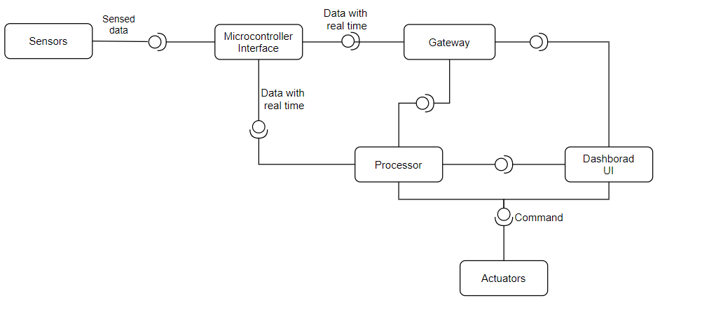
Component diagram.

Slide 9
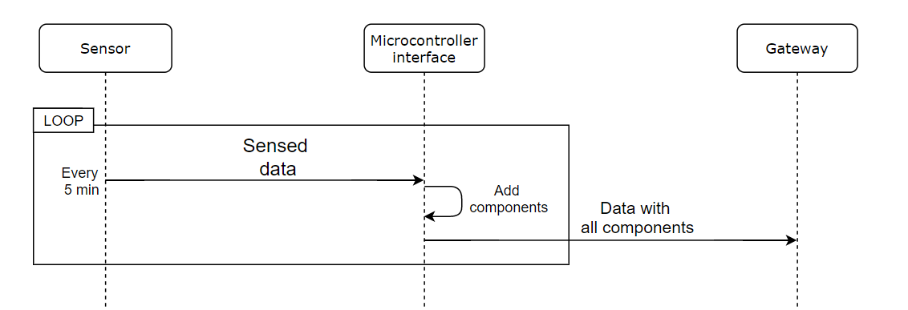
Sequence of data collection

Slide 10
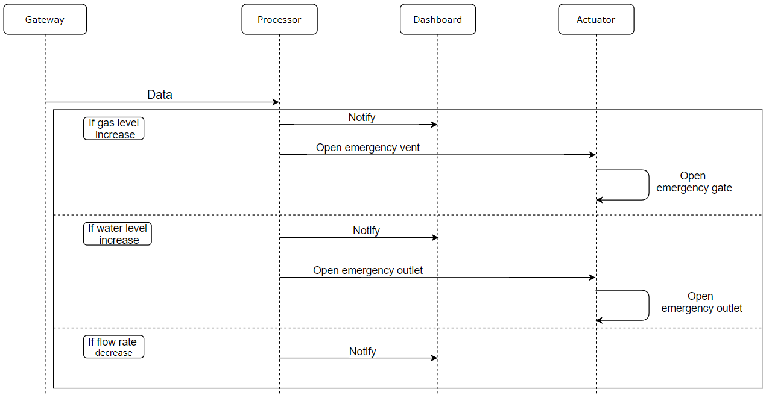
Sequence of work process

Slide 11
Architecture of MAPE K

Slide 12
Monitor
The monitor function aggregates, correlates and filters these details until it determines a symptom that needs to be analyzed. In our case we are publishing the data through MQTT box for publishing the data into our system.

Slide 13
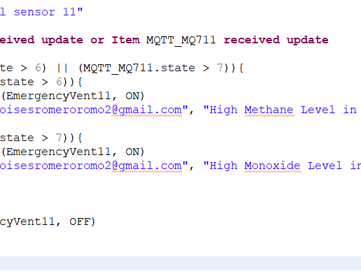
Analyze
Perform complex data analysis and reasoning on the symptoms provided by the monitor function.
If changes are required, a change request is logically passed to the plan function

Slide 14
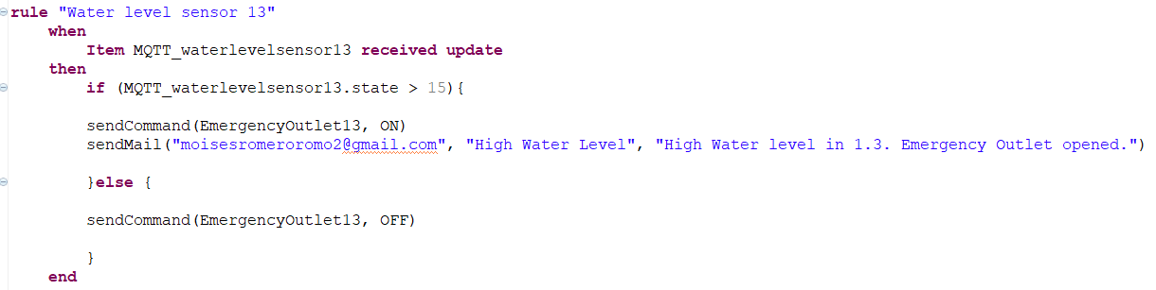
Plan
Structures the actions needed to achieve goals and objectives.
The plan function creates or selects a procedure to enact a desired alteration in the managed resource.
The plan function can take on many forms, ranging from a single command to a complex workflow.

Slide 15
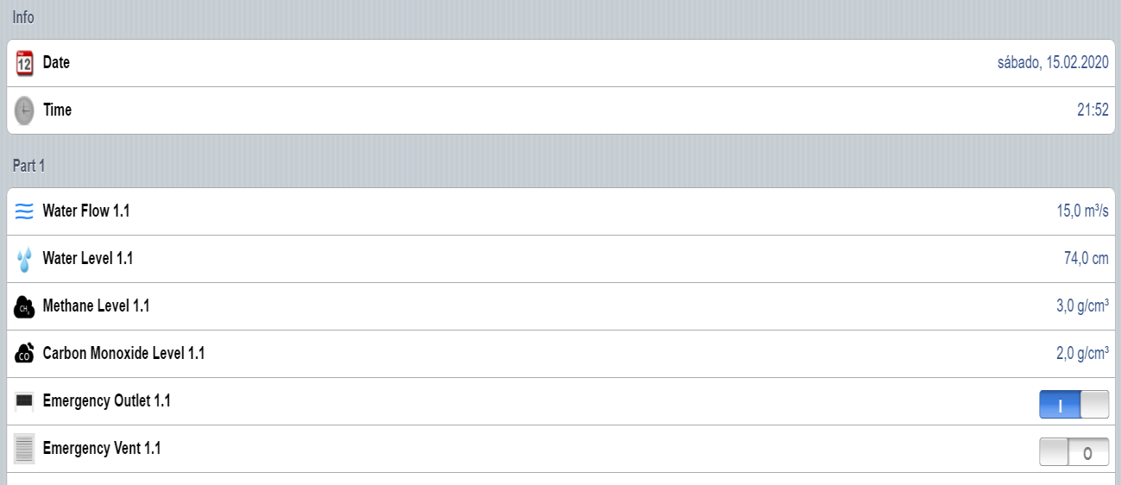
Execute
Changes the behavior of the managed resource using effectors, based on the actions recommended by the plan function

Slide 16
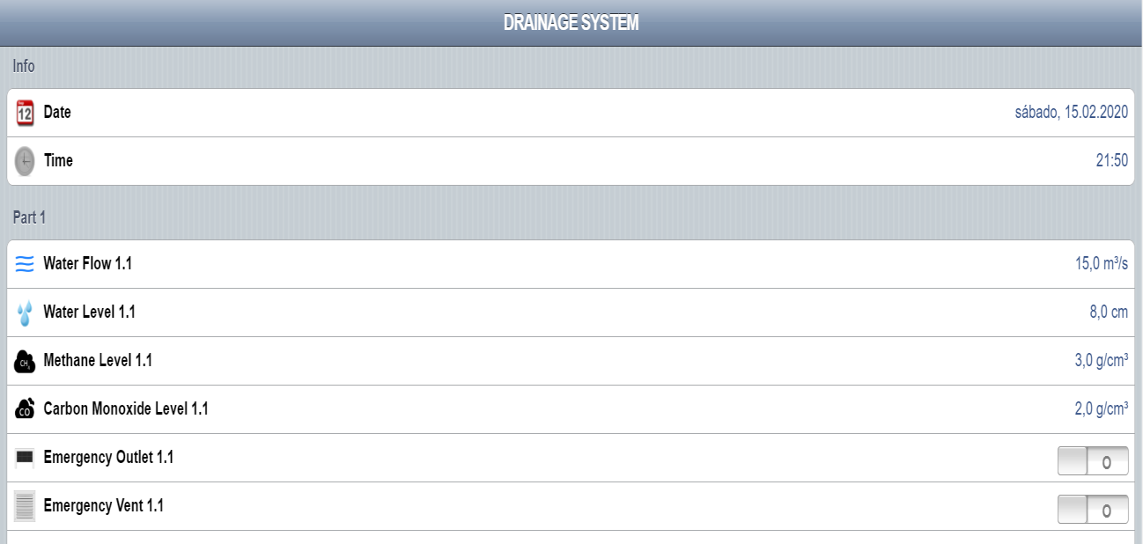
Knowledge
Standard data shared among the monitor analyze plan and Standard data shared among the monitor, analyze, plan and execute functions.
The shared knowledge includes data such as topology information, historical logs, metrics, symptoms and policies.
Created by the monitor part while execute part might update the knowledge.

Slide 17
Conclusion
By using various sensors such as gas detection, water level as well as blockage detection we can monitor the real time scenario of drainage system by for detecting the problems in drainage system.
By doing this we can able to take particular action on the problems as we will receive the early alerts of blockage as well as increase.

Slide 18
REFERENCES
Brown, Eric (13 September 2016).”Who need the Internet of things”.Linux.com. Retrieved 23 October 2016.
Basha, D. and Rus, D. “Design of Early Warning Flood Detection System for developing countries. Proceeding of the conference on ICTD, Bonsalove, India. Pp 1- 10, 2007.
Retno Tri Wahyuni1* Yusmar Palapa Wijaya2 Dini Nurmalasari “Design of Wireless Sensor Network for Drainage Monitoring System” Vol.5, No.5, 2014

Slide 19



